Slide 1
Discrimination:
The Journey
JENNIFER EADY Q.C.
OLD SQUARE CHAMBERS

Slide 2

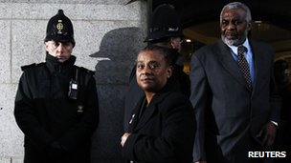
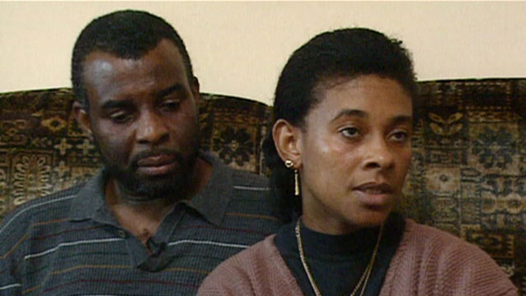
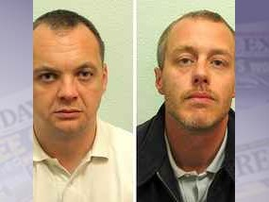
From 1993 to 2012

Slide 3
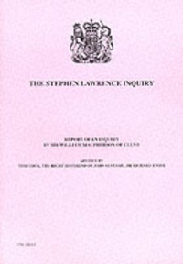
The Impact

Slide 4
Macpherson:
“it is incumbent upon every institution to examine their policies and the outcome of their policies and practices to guard against disadvantaging sections of our communities”

Slide 5
The Public Sector Equality Duty
Formerly the race, disability and gender duties (s 71 RRA, s 49A DDA, s 76A SDA)
Now a general equality duty, under s 149 Equality Act 2010

Slide 6
The General Duty
A public authority must, in the exercise of its functions, have due regard to the need to –
  Eliminate discrimination, harassment, victimisation and any other conduct that is prohibited by or under this Act;
  Advance equality of opportunity between persons who share a relevant protected characteristic and persons who do not share it;
  Foster good relations between persons who share a relevant protected characteristic and persons who do not share it.

Slide 7
Sex
Race
Pregnancy and maternity
Gender Reassign-ment
The relevant Protected Characteristics
Disability
Religion
Or Belief
Age
Sexual Orientation

Slide 8
Applicable to:
A public authority, per Sched 19 Equality Act 2010
A person who is not a public authority but who exercises public functions

Slide 9
Due Regard
Proportionality and relevance – the regard that is appropriate in all the circumstances
But the duty is not to achieve a result but to have ‘due regard’ to the need to achieve the goals set out in s 149 (Baker and ors)

Slide 10
Advancing Equality of Opportunity
Remove or minimise disadvantages suffered by persons who share a relevant protected characteristic that are connected to that characteristic | Take steps to meet the needs of persons who share a relevant protected characteristic that are different from the needs of persons who do not share it; | Encourage persons who share a relevant protected characteristic to participate in public life or in any other activity in which participation by such persons is disproportionately low

Slide 11
The Equality Duty –GEO Guidance
Knowledge – involving a conscious approach and state of mind with regards to the Equality Duty
Timeliness – to be complied with before or at the time of the decision
Real Consideration – it must form an integral part of the decision-making process
Sufficient information – must consider what further information may be needed in order to give proper consideration
No delegation – public bodies are responsible for ensuring that any third parties which exercise functions on their behalf are compliant
Review – regard to the Equality Duty must be given when a policy is implemented and reviewed as well as developed as the Equality Duty is a continuing one.
Keeping a record of how decisions were reached and in particular how considerations of all three parts of the Equality Duty played a part in that will help public bodies demonstrate compliance.

Slide 12
The General Equality Duty in practice - Brown
Have due regard to the identified goals
Have that due regard before and at the time the policy in issue is being considered.
The duty must be exercised in substance, with rigour and open mind.
The duty is non-delegable and continuing
It is good practice to keep an adequate record
Mainstreaming the equality duty into decision making
Not a tick-box exercise

Slide 13
Specific Duties
To enable better performance of the general equality duty:
  publication of information – to employees if 150 or more
  publication of objectives – must be specific and measurable

Slide 14
Enforcement:
Judicial Review – recent egs of cases challenging budget cuts, but success may ultimately be unfulfilling and cases depend on characterisation by protected status rather than impact upon those adversely affected more generally
EHRC enforcement

Slide 15
The Potential for a Wider Impact
How the public sector can influence the private sector – s 17(10) Local Govt Act 1988 (as amended)
The culture change – the case study

Slide 16
The Continuing Challenges
The extension of protection: disability, age, sexual orientation, religion or belief
A ‘one-size fits all’ solution?
The particular difficulties in religion or belief cases.

Slide 17
The Relativist Approach?
I doubt whether it is right for the court, except in extreme cases, … to impose an evaluative filter at the first stage, especially where religious beliefs are involved … Only in clear and extreme cases can a claim to religious belief be disregarded entirely
  Genuinely held
  Not opinion or viewpoint.
  Weighty + substantial aspect of human life/behaviour.
  Certain level of cogency, seriousness, cohesion and importance;
  Worthy of respect in democratic society; not incompatible with human dignity; no conflict with fundamental rights of others.
Williamson
Grainger

Slide 18
Direct or Indirect Discrimination?
Azmi v Kirklees
McFarlane v Relate
Ladele v Islington
Eweida v British Airways

Slide 19
Does it matter?
Absurd characterisation of the case.
The potential for inconsistency/value judgments by tribunals as between beliefs.
How to demonstrate disadvantage?
How can employers avoid adverse impact?
Generally, public confidence.

